Slide 1
Creating Public Awareness for Disaster Risk Reduction in Udayapur, Nepal
Presented By
Dibakar Babu Bhatarai
Dhiraj Bikram lawati
LBD7 Action Plan

Slide 2
Introduction
A disaster is a serious disruption of the functioning of a community or a society involving widespread human, material, economic or environmental losses and impacts, which exceeds the ability of the affected community or society to cope using its own resources.

Slide 3
Types of Disaster
Natural
Technological
Intentional

Slide 4
Earthquake history
The devastating earthquake of 7.8 in Richter scale that struck the country with its epicenter at Mandre, Barpak VDC-02, Gorkha at 11:56 am on 2072 Baisakh 12 (corresponding to 25 April 2015) and its frequent aftershocks chiefly the two fatal ones dated 26 April and 12 May 2015 have caused an inconceivable loss of lives and properties.
Thousands of people have been killed, thousands injured and hundreds of thousands of houses completely destroyed and many people rendered homeless.
Many government and public office buildings, historical, cultural and archeological heritages have been destroyed; physical infrastructures including public and private school buildings, bridges, roads, etc. have also been destroyed.

Slide 5
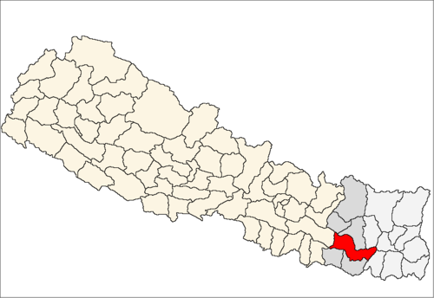
Udayapur, Nepal
Population, c. 2.8 million
400km Northeast of Kathmandu
Was affected by the earthquake
We are residents of Mt.
Everest zone, but
graduate students
studying in Kathmandu

Slide 6
Objectives
Helping reducing the suffering from disasters;
Greater multidisciplinary cooperation in disaster management;
Giving hope in concrete ways for recovery of communities from disasters;
Development of evaluation and fund raising skills;
Do something for our hometown.

Slide 7
Implementation Strategy
Coordinating with Local Government Agencies
Holding a Coordination meeting with identified potential organizations
Follow-up with partners
Promotion through social media

Slide 8
Participants and Activity
Training workshop and activity
1 day event
Open to everyone
Experts from different fields

Slide 9
Challenges
Financial Support
Expert/Facilitators
Lack of knowledge of DDR concept

Slide 10
Outcomes
Involvement of youth in Disaster Management in Nepal
Motivation to Community Leaders on Rescue Operations during Disaster
Finding the degree of Vulnerability a district receives during a Disaster

Slide 11
Timeline for Awareness Program
1 week for preparing Proposal
2 weeks to get all approvals
2 months for publicity
1 day for the event (10 March 2016)
Evaluation 1 week after the event

Slide 12
Funding Resources
Triyuga Municipality
Youth’s UNESCO Club Nepal
Harit Sewa Samaj Udayapur Nepal
Fulabari Youth’s Club

Slide 13
Estimated Budget (USD)
Publicity $200
Venue $200
Miscellaneous Expenses $400
Total $ 800

Slide 14
Expected Date
Public Awareness for Disaster Risk Reduction
Udayapur Nepal
10 March 2016

Slide 15
Partners
Triyuga Munciplity Udayapur Nepal
Youth’s UNESCO Club Nepal
Harit Sewa Samaj Udayapur Nepal
Triyuga FM
Triyuga College

Slide 16
Contact
Dibakar Babu Bhattarai
Gmail: dayvatbro11@gmail.com
Mobile No.:+977-9851147152/9815793864
Dhiraj Bikram lawati
Contact no :9851172859

